Slide 1


Analysis of copy number signatures using admixture models

Slide 2
Mutational processes and signatures

Slide 3



Mutational processes and signatures
Reference human genome
Each individual suffers different mutations
Genome 1
Genome 2
Genome 3

Slide 4
Mutational processes and signatures
Define the features of the genome to study
Look for patterns in the mutations
Associate the results with clinical data

Slide 5
Signature analysis
Patient 1
Patient 2
Patient 3
Feature extraction
SNVs
CNAs
…

Slide 6
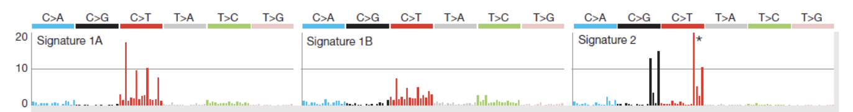
Signature analysis
Signature extraction and identification
Genome 1
Genome 2
Genome 3

Slide 7
Signature analysis
Signature assignment
- Associate signatures with possible causes
- Survival analysis
- Mutations of interest
- Personalized treatments

Slide 8
SNV signatures

Slide 9
SNV signatures (Alexandrov et al 2013)
Reference:
… A C C T G C T A …
Sample:
… A C C T C C T A …
Prior base
(4 possibilities)
SNV
(6 possibilities)
Posterior base
(4 possibilities)
96 types of SNVs (Components)
Features -> SNV, Prior base, Posterior base
The features are divided into components

Slide 10
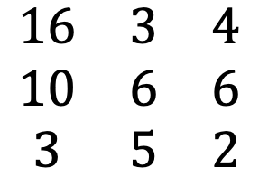
SNV signatures (Alexandrov et al 2013)
Sample by component matrix
Type 1
Type 2
Type 3
Sample 1
$$\begin{matrix}16 & 3 & 4 \\ 10 & 6 & 6 \\ 3 & 5 & 2\end{matrix}$$
…
Sample 2
Sample 3
…
…
Number of repetitions

Slide 11


SNV signatures (Alexandrov et al 2013)
components
signatures
samples
A
$$\sim$$
W
H
$$×$$
samples
components
signatures
NMF

Slide 12
SNV signatures (Alexandrov et al 2013)
samples
H
For each sample, this matrix shows the proportions of each signature
signatures

Slide 13
SNV signatures (Alexandrov et al 2013)
signatures
W
For each signature this matrix shows the contributions of every component
components
Given a new sample, this matrix allow us to calculate the proportions of each signature

Slide 14
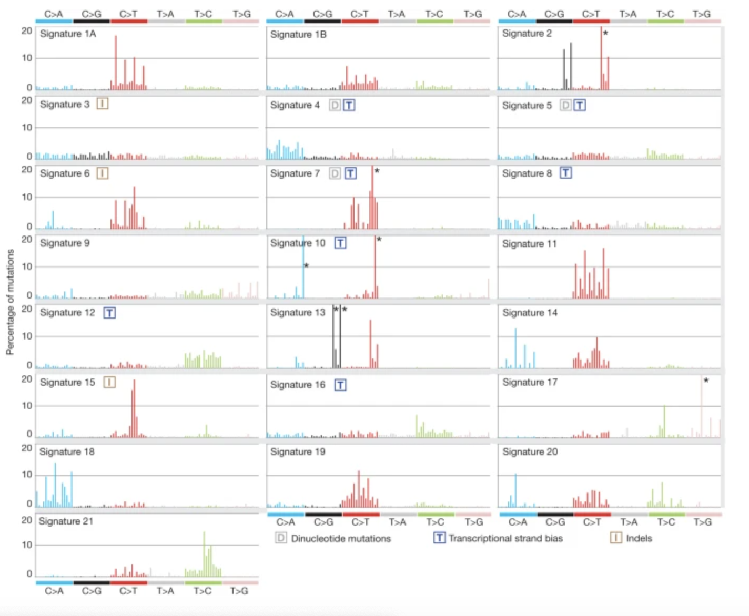
SNV signatures (Alexandrov et al 2013)
Alexandrov defined 21 signatures for SNVs in different types of cancer

Slide 15
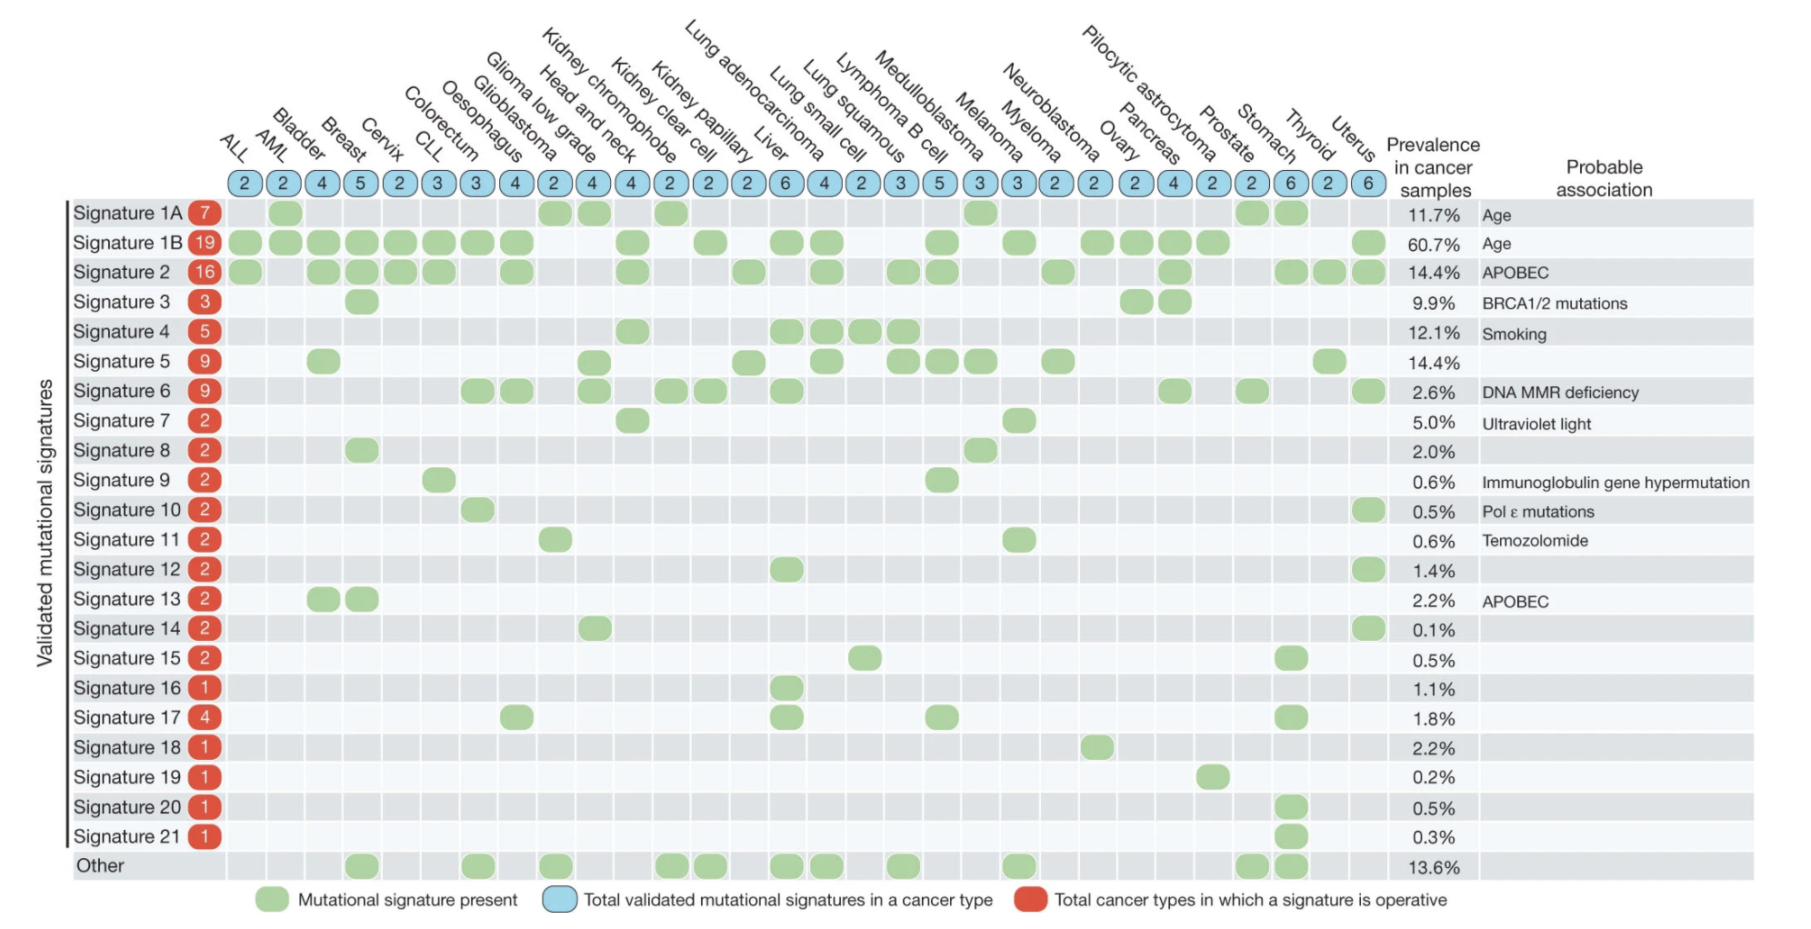
SNV signatures (Alexandrov et al 2013)
And identified some associations to these signatures

Slide 16
CN signatures

Slide 17
CN signatures (Geoff et al 2018)
Patient 1
Patient 2
Patient 3
Feature extraction
SNVs
CNAs
…

Slide 18
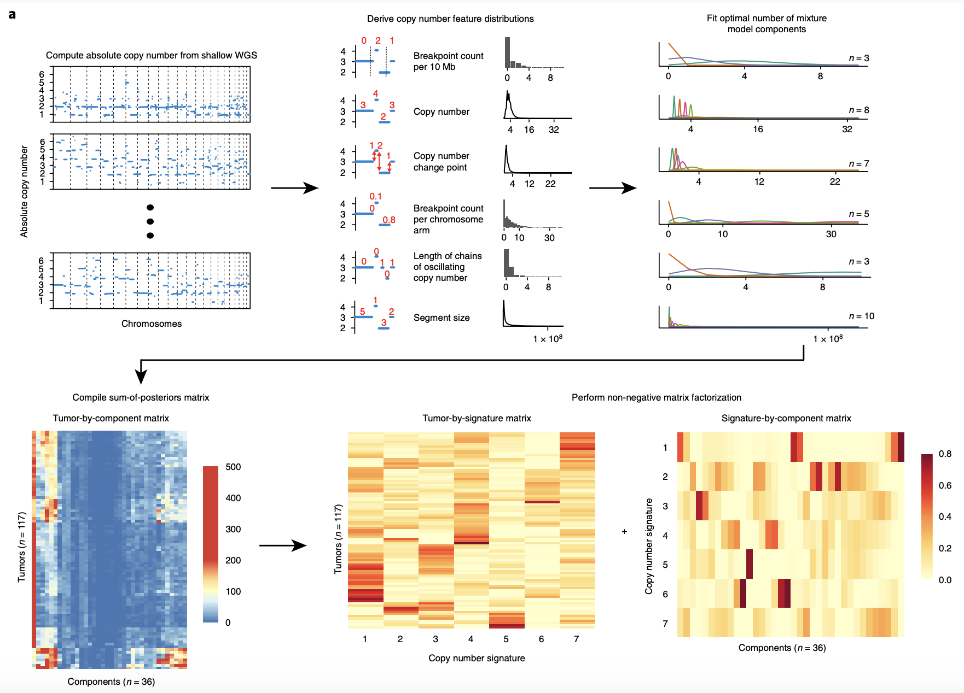
CN signatures (Geoff et al 2018)

Slide 19
CN signatures (Geoff et al 2018)
CN signatures (Geoff et al 2018)

Slide 20
CN signatures (Geoff et al 2018)
CN signatures (Geoff et al 2018)
Mixture Models

Slide 21
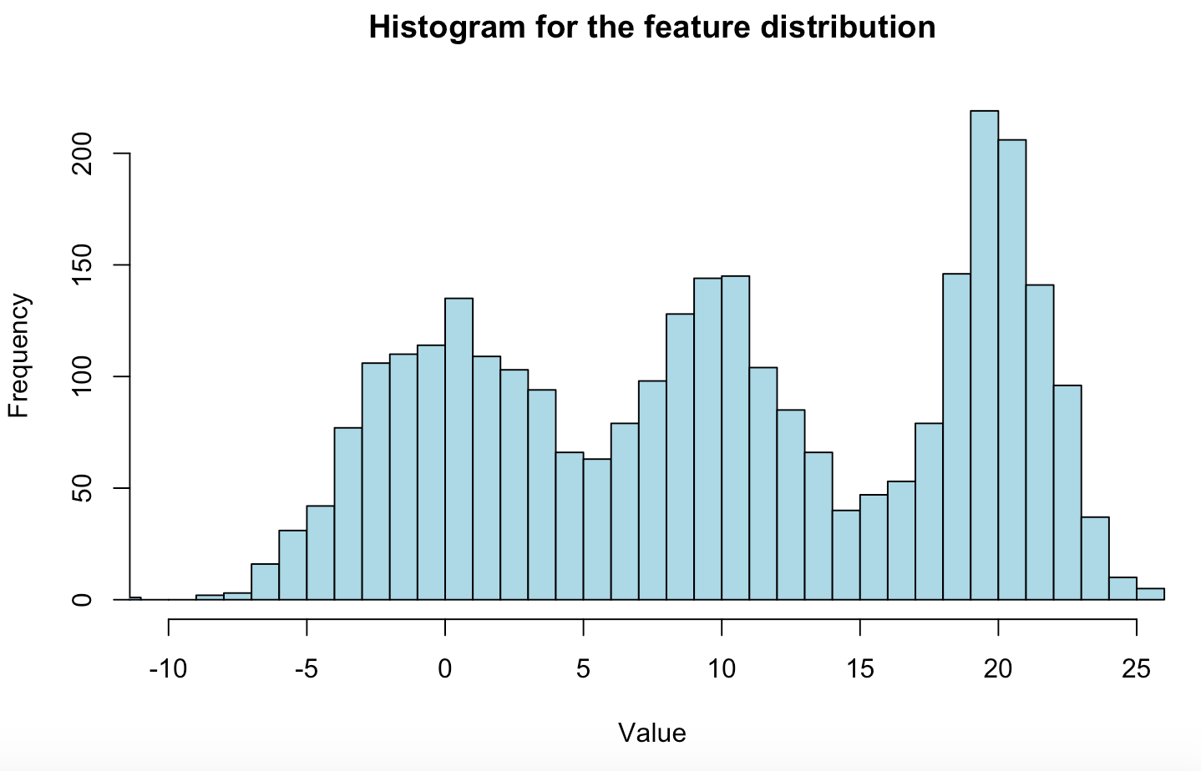
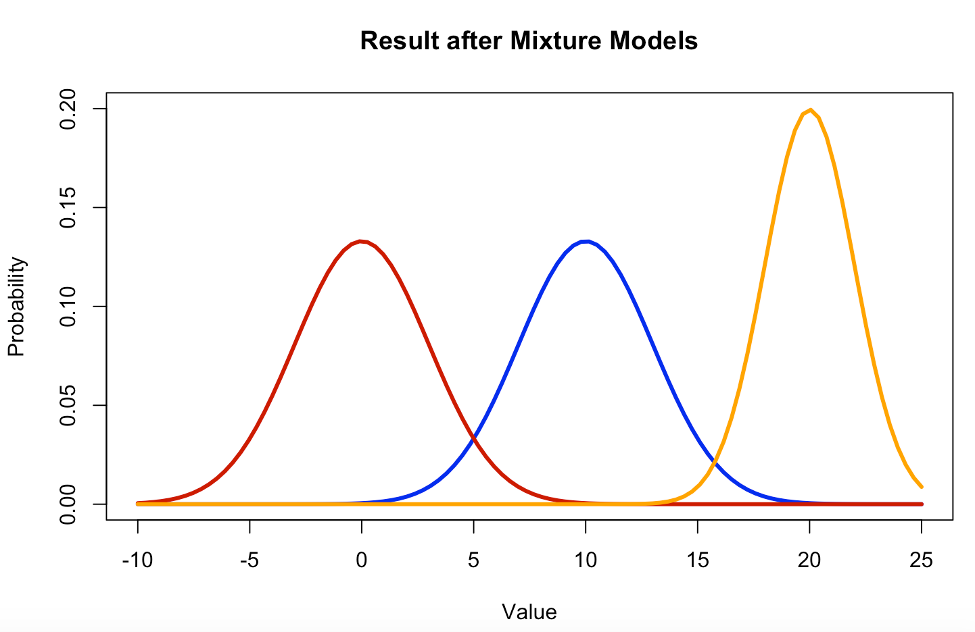
Mixture models (Geoff et al 2018)
CN

Slide 22
CN signatures (Geoff et al 2018)
Sum of posterior
probabilities

Slide 23
CN signatures (Geoff et al 2018)
NMF

Slide 24
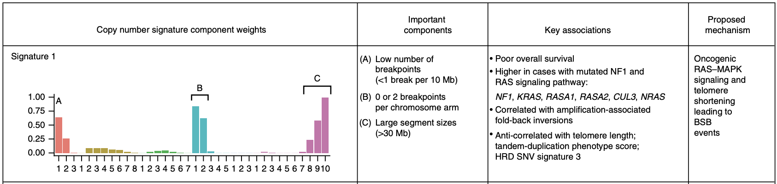
CN signatures (Geoff et al 2018)

Slide 25
Admixture models, an alternative to NMF

Slide 26
Latent Dirichlet Annotation (Shiraishi et al 2015)
Step 0: Feature identification
Choose number of signatures and features to study
NOTE:
Shiraishi assumes independence between the features, which reduces significantly the number of components

Slide 27
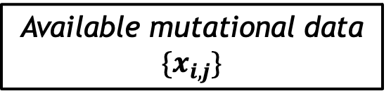
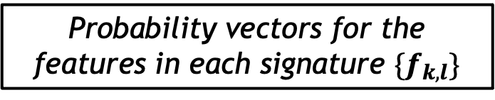
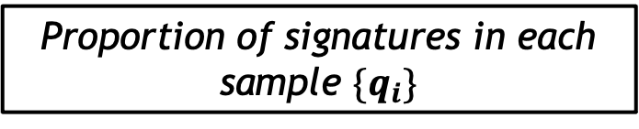
Latent Dirichlet Annotation (Shiraishi et al 2015)
Step 1: Expectation Maximization algorithm
Proportion of signatures in each sample ${\{q}_{i}\}$
EM
algorithm
Available mutational data $\{x_{i,j}\}$
Probability vectors for the features in each signature $\{f_{k,l}\}$

Slide 28
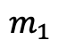
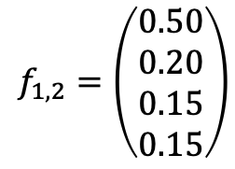
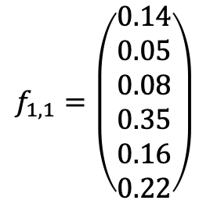
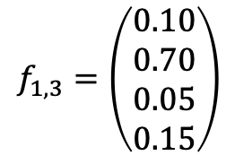
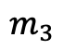
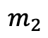
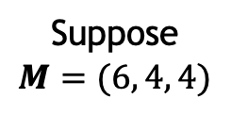
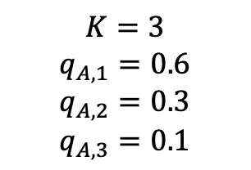
Admixture model (Shiraishi et al 2015)
N samples
$$m_{1}$$
$$f_{1,1}=\left(\begin{aligned}0.14 \\ 0.05 \\ 0.08 \\ 0.35 \\ 0.16 \\ 0.22\end{aligned}\right)$$
Consider one of
these samples,
let us call it ‘A’
Suppose
$$M=(6, 4, 4)$$
$$m_{2}$$
$$f_{1,2}=\left(\begin{aligned}0.50 \\ 0.20 \\ 0.15 \\ 0.15\end{aligned}\right)$$
Probability vectors
for signature 1
$$K=3$$
$$q_{A,1}=0.6$$
$$q_{A,2}=0.3$$
$$q_{A,3}=0.1$$
$$m_{3}$$
$$f_{1,3}=\left(\begin{aligned}0.10 \\ 0.70 \\ 0.05 \\ 0.15\end{aligned}\right)$$

Slide 29
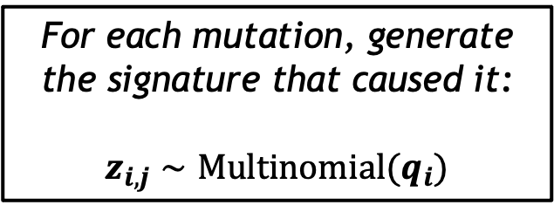
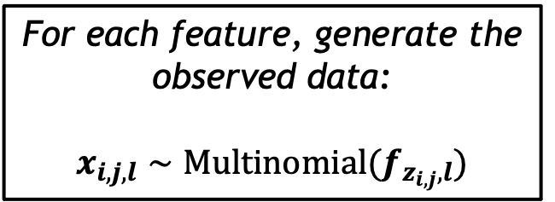
Admixture model (Shiraishi et al 2015)
Step 2: Data generation
For each mutation, generate the signature that caused it:
$$z_{i,j}∼Multinomial(q_{i})$$
For each feature, generate the observed data:
$$x_{i,j,l}∼Multinomial(f_{z_{i,j},l})$$

Slide 30
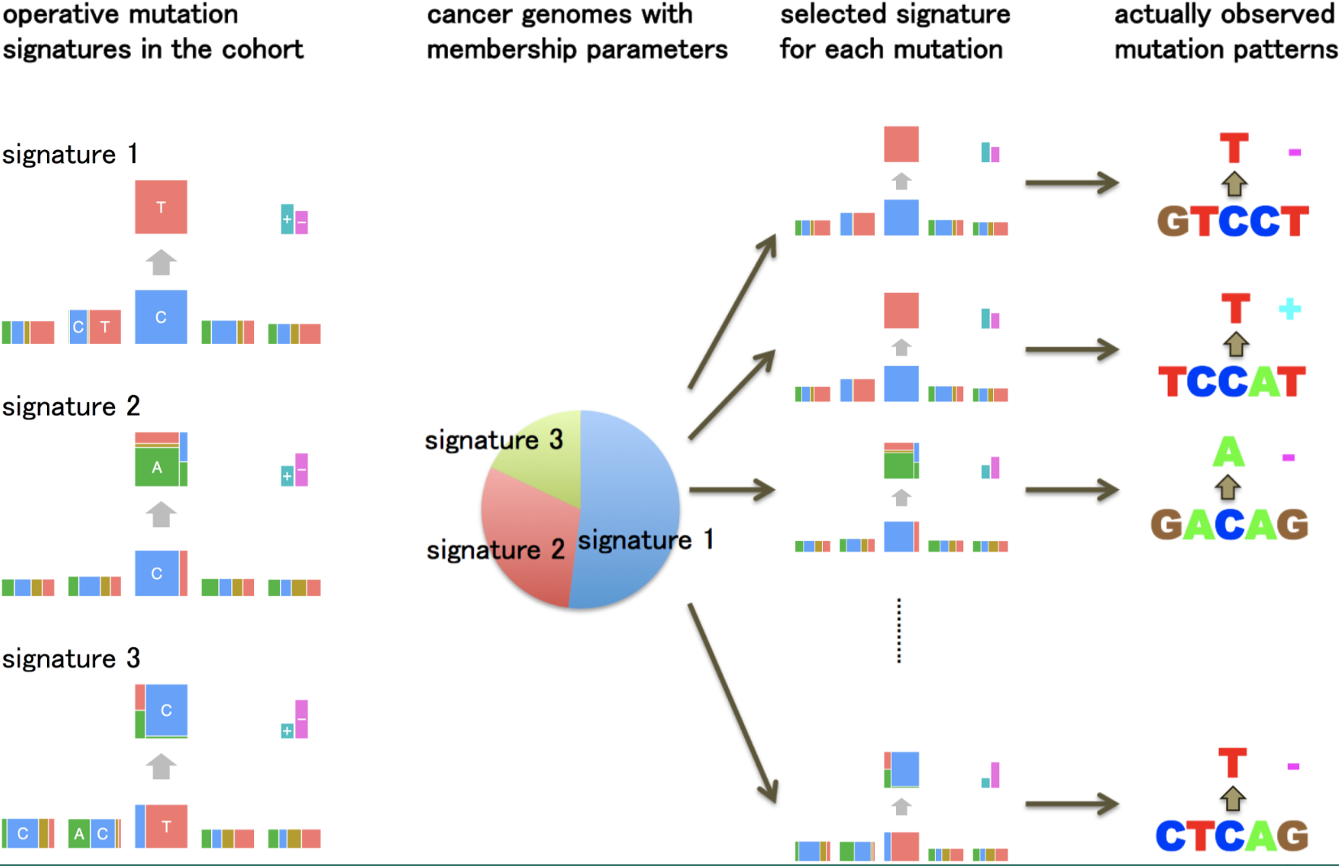
Admixture model (Shiraishi et al 2015)

Slide 31
Using AM for
CN signatures

Slide 32
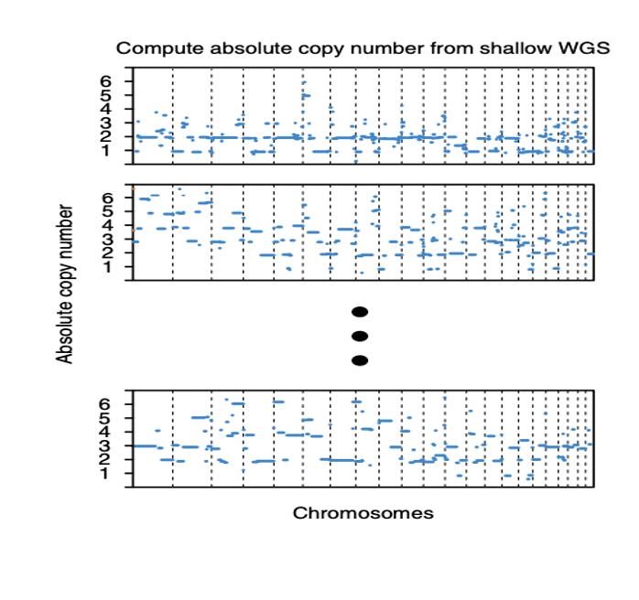
The data
Data from HGSOC, a CN driven tumour.
Absolute CN obtained with sWGS
CN values approximated to closest integer

Slide 33
The definition of a segment
Alternative 1
Alternative 2
Segment 1
Segment 2
Segment 3
10 Mb
10 Mb
10 Mb
Segment 3
Segment 5
Copy number
Segment 1
Segment 4
Copy number
Segment 2
Position
Position

Slide 34
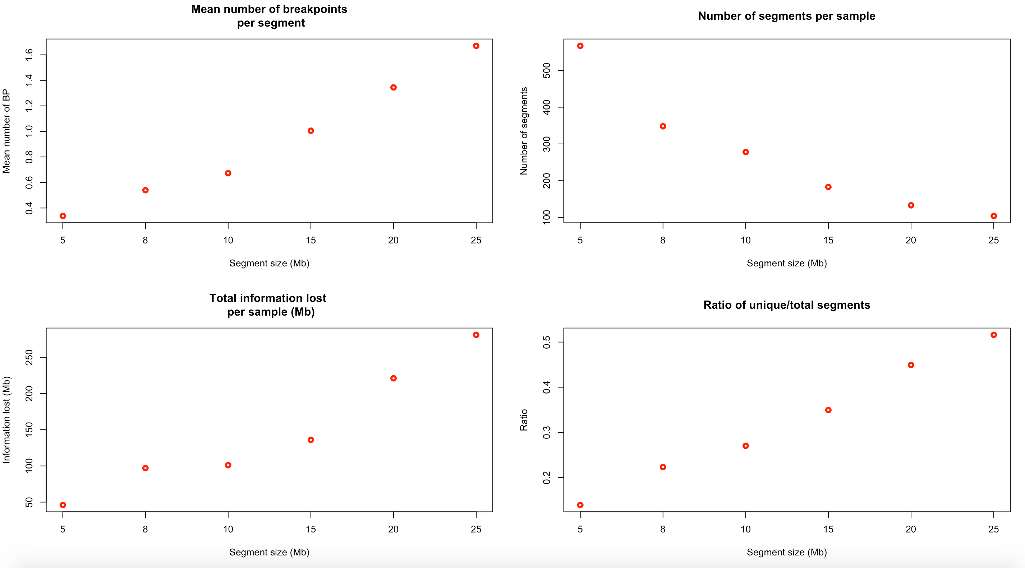

The size of the segments (Alternative 1)
The segment size for the first alternative

Slide 35
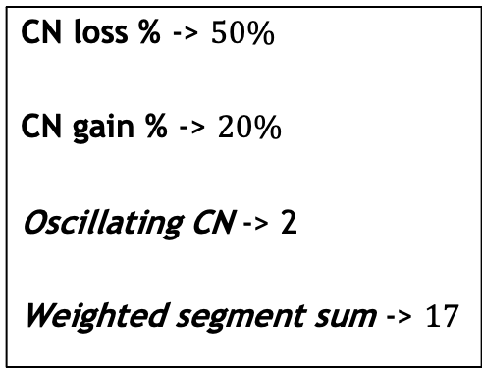
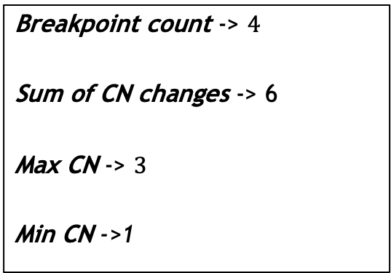
Segment features (Alternative 1)
Segment features
Breakpoint count -> $4$
Sum of CN changes -> 6
Max CN -> $3$
Min CN ->1
CN loss % -> $50\%$
CN gain % -> $20\%$
Oscillating CN -> 2
Weighted segment sum -> $17$

Slide 36
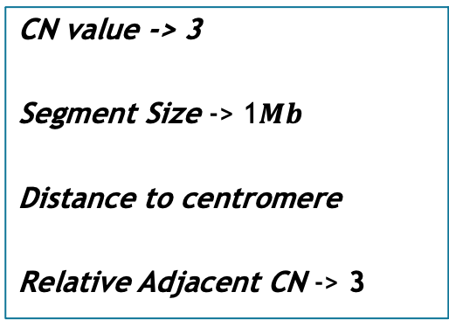
Segment features (Alternative 2)
Segment to study
Segment features
CN value -> 3
Segment Size -> 1$Mb$
Distance to centromere
Relative Adjacent CN -> 3

Slide 37
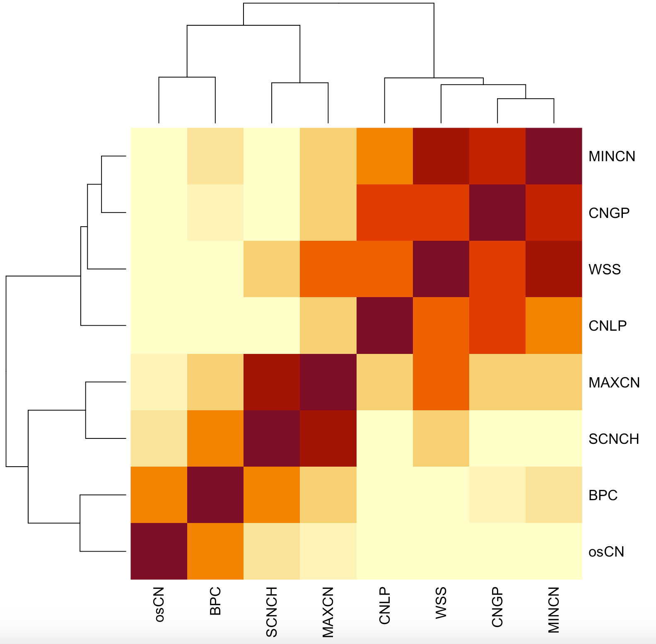

Correlation between features (Alternative 1)
Correlation
(abs. value)
1
0

Slide 38
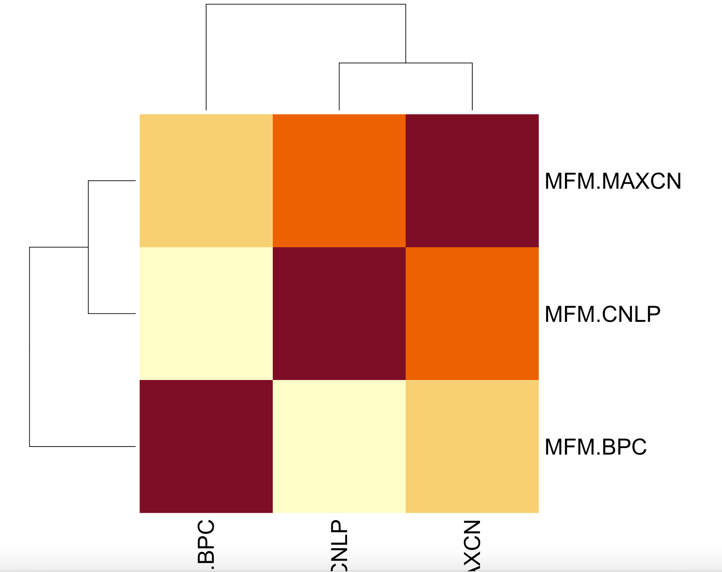
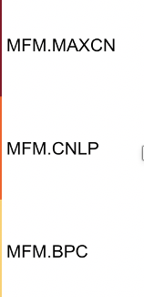
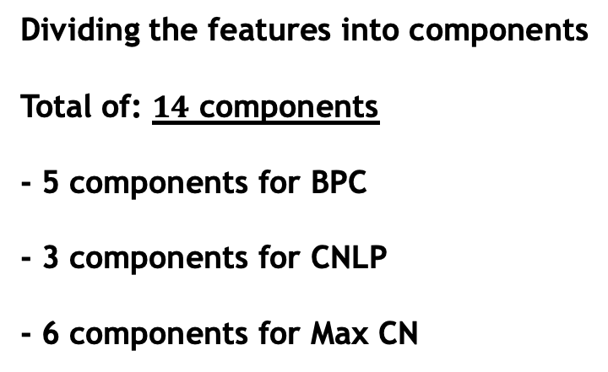
Choosing the features (Alternative 1)
Dividing the features into components
Total of: $14$ components
- 5 components for BPC
- 3 components for CNLP
- 6 components for Max CN

Slide 39
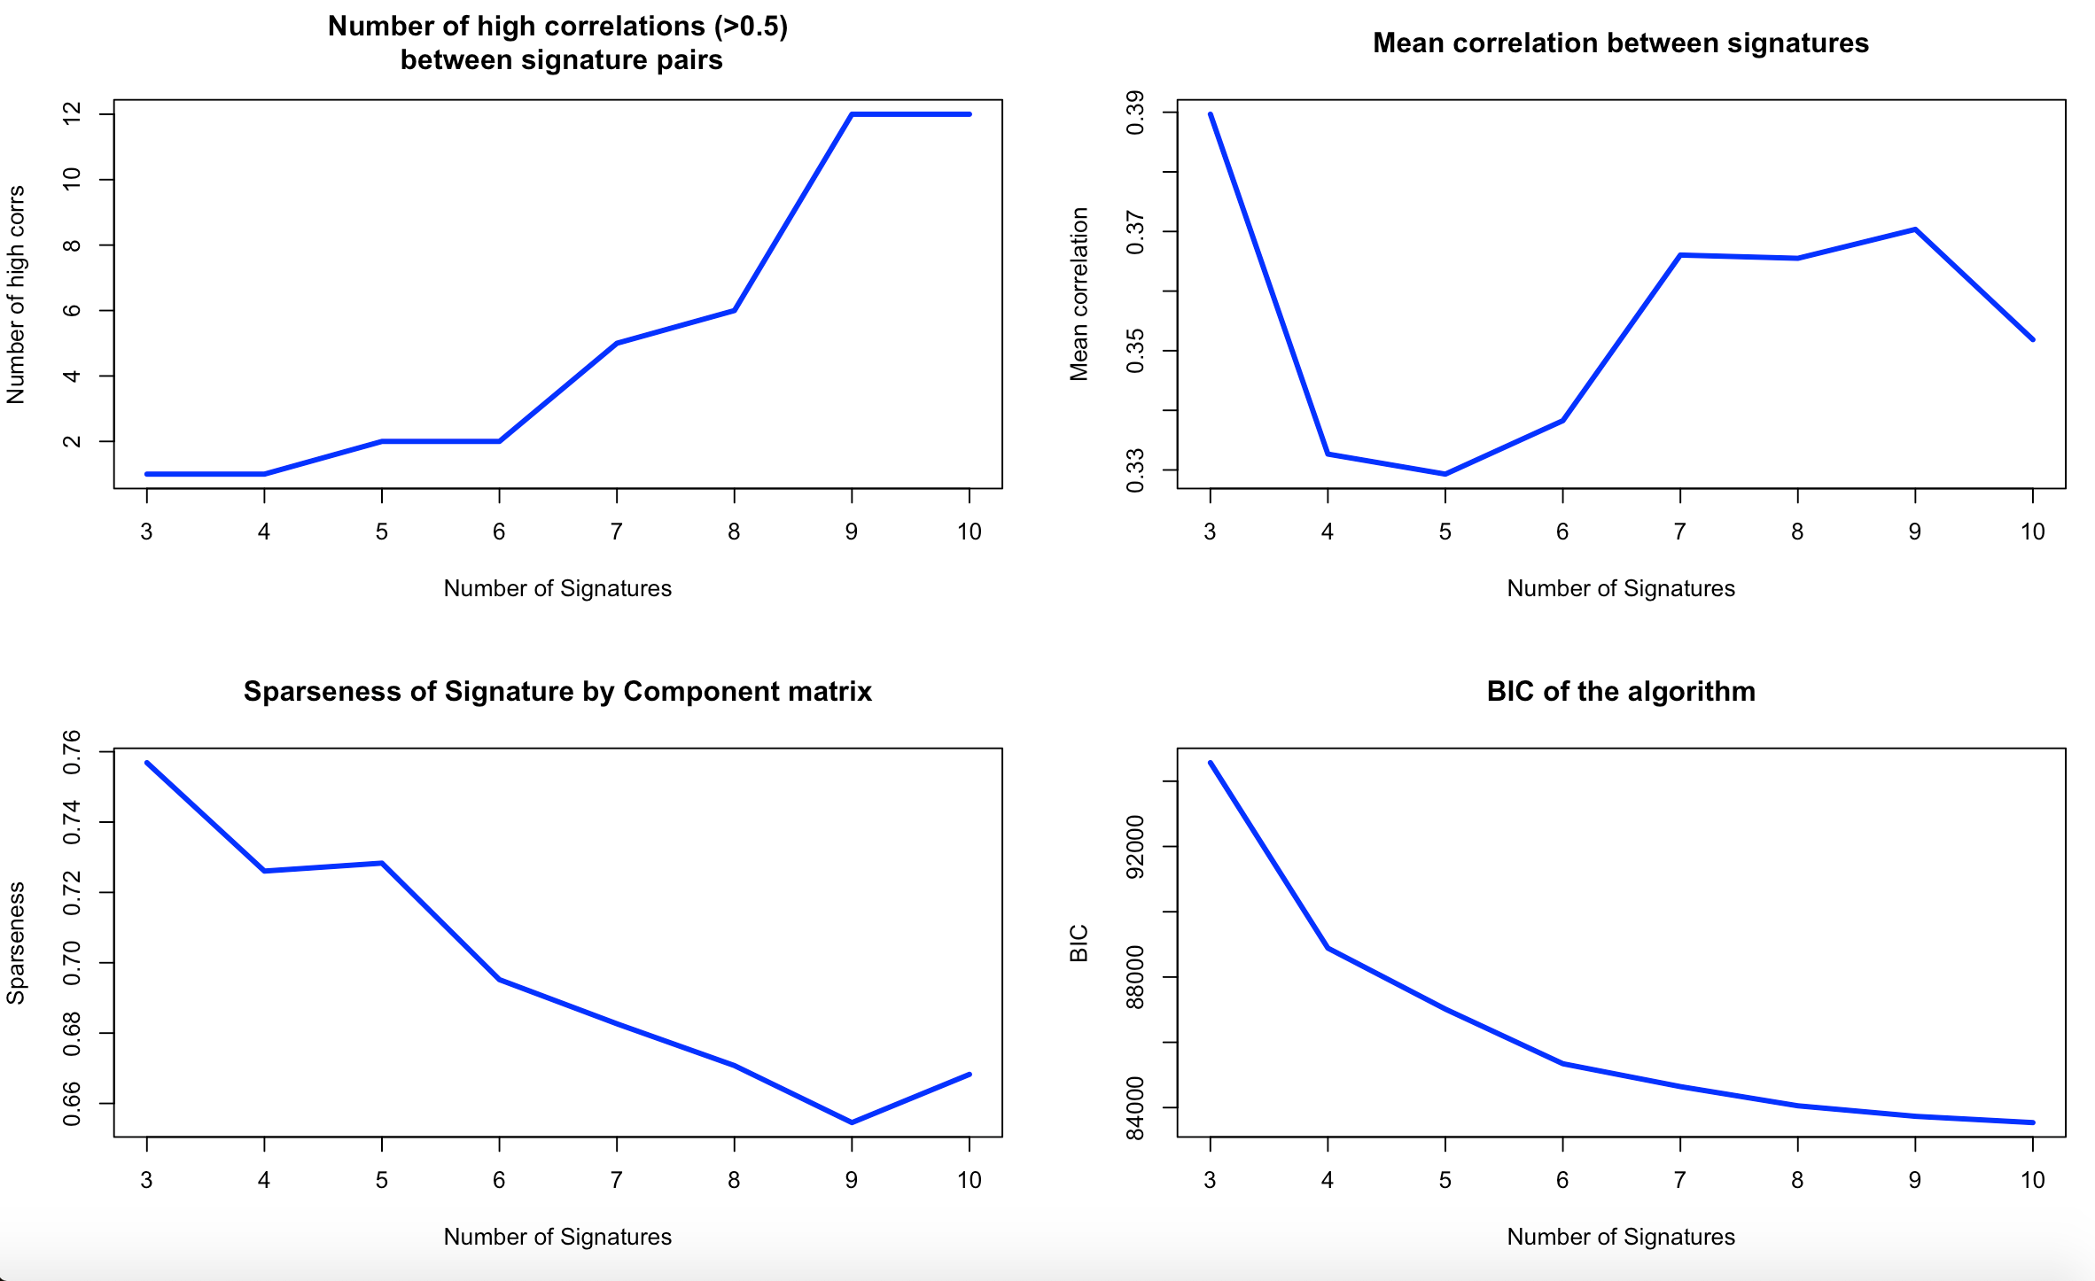

Optimal number of signatures (Alternative 1)

Slide 40
Results

Slide 41
Deciding the alternative
- The first idea was to choose alternative 1 as it allows us to explore more features
- Most features are highly correlated
- Information is lost
- Final decision: Alternative 2

Slide 42
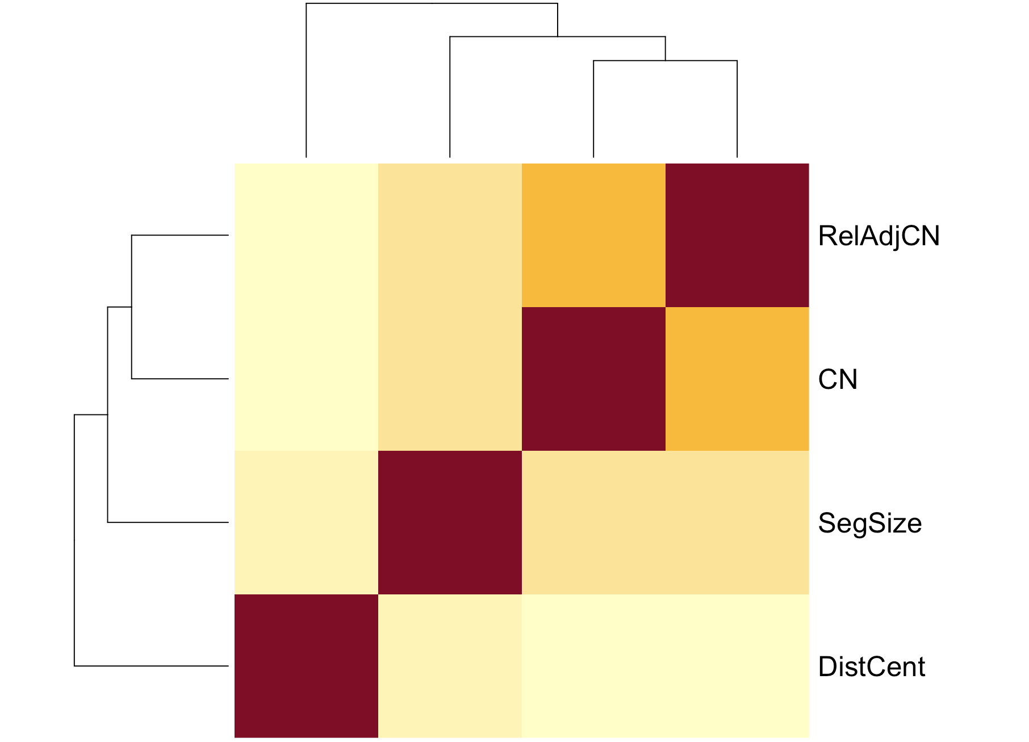
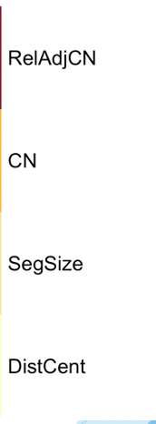
Feature correlation (Alternative 2)
Correlation
(abs. value)
Total of: 20 components
- 7 components for CN
- 6 components for SegSize
- 4 components fo DistCent
- 3 components for RelAdjCN
1
0

Slide 43
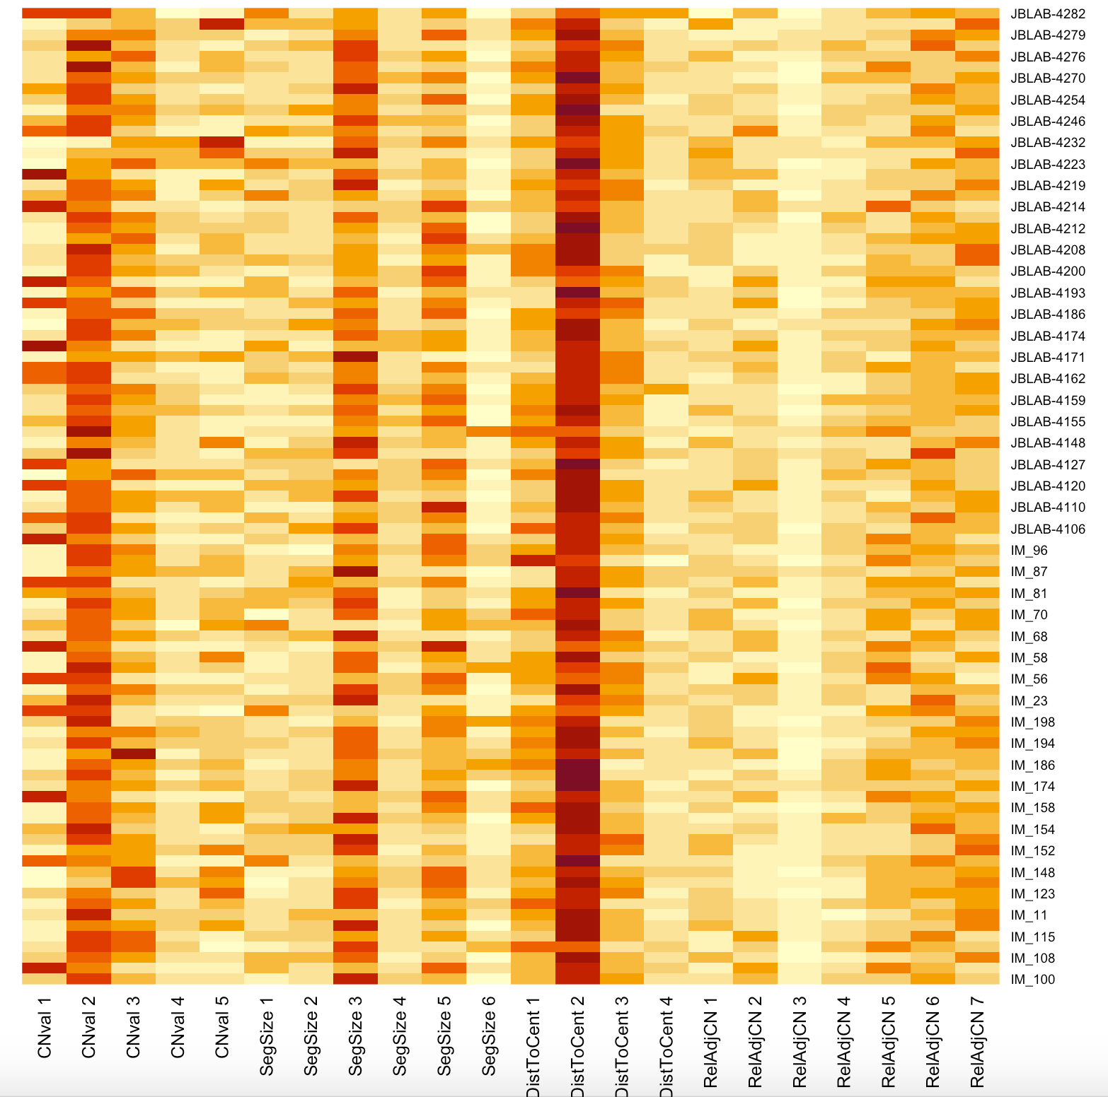
Sample by component matrix (Alternative 2)
Alternative 2
- 4 features
- 22 Components
- 4 signatures

Slide 44
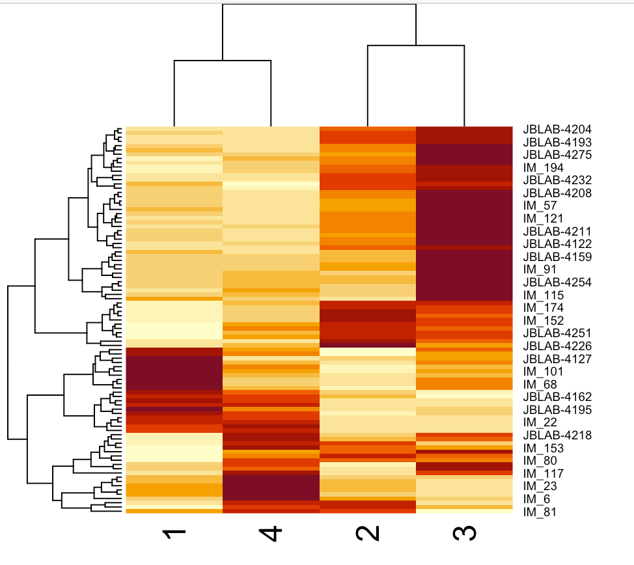
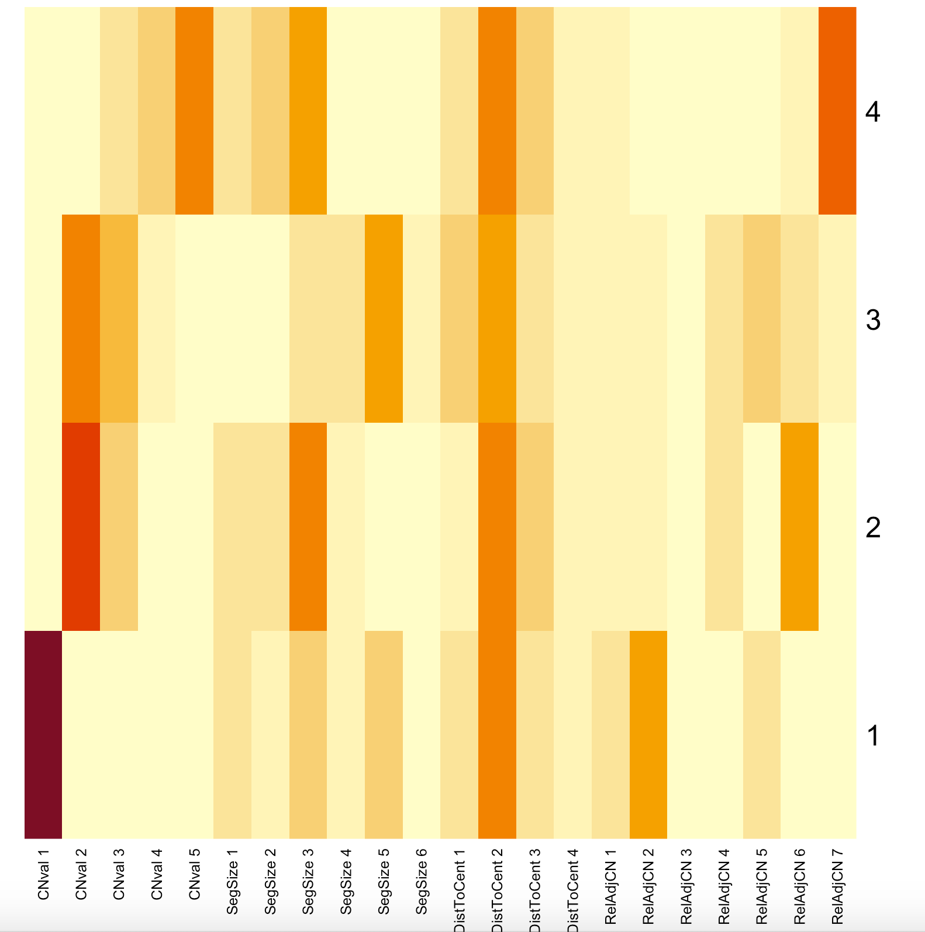
Main results for Alternative 2
Sample by Signature
Signature by Component

Slide 45
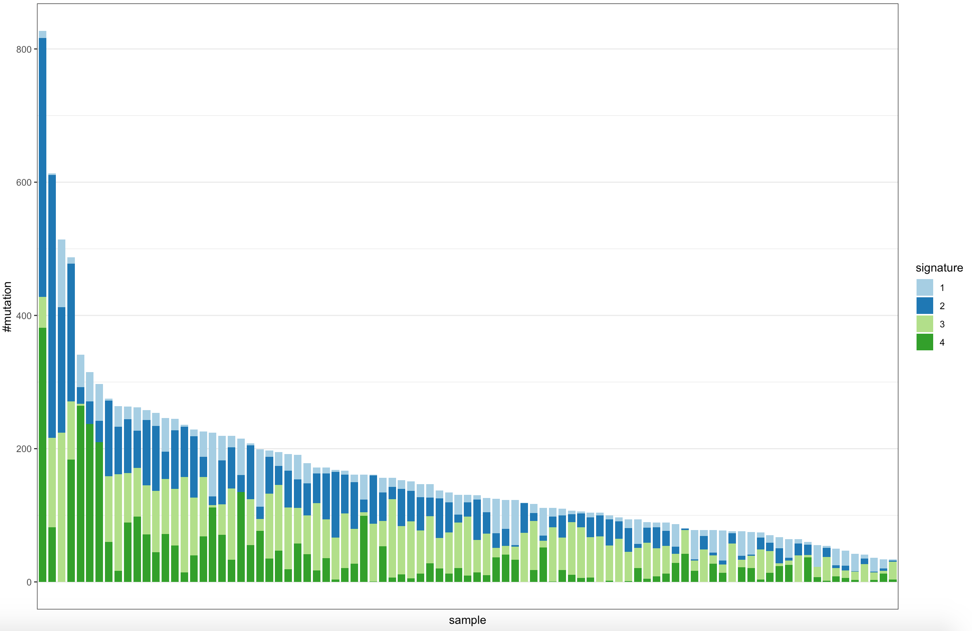
Signature exposures and number of mutated segments

Slide 46
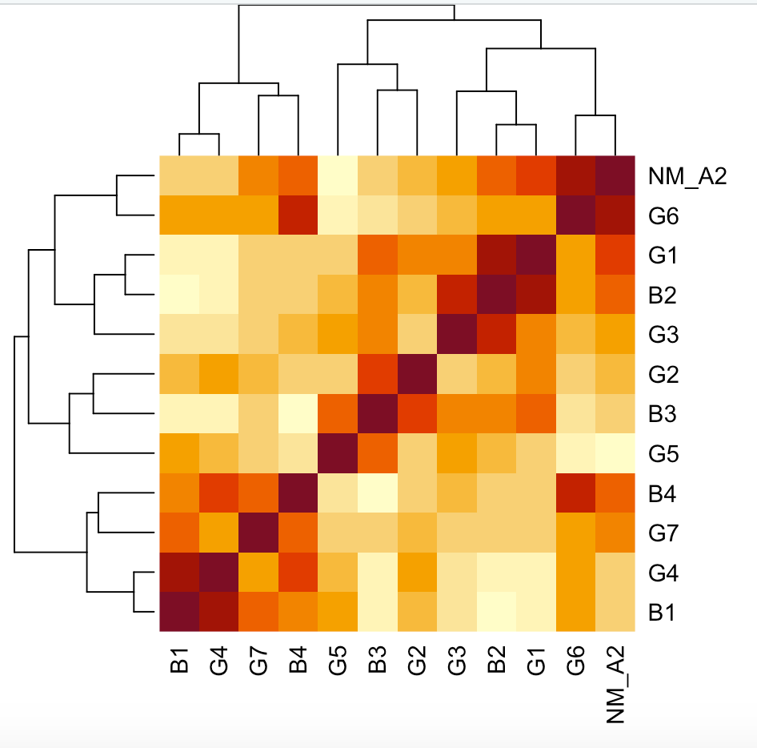
Comparison with Geoff’s signatures
Some signatures are highly correlated with Geoff’s
B1-B4 = Alternative 2 Signatures
G1-G7 = Geoff’s Signatures
NM_A2 = Number of mutated segments

Slide 47
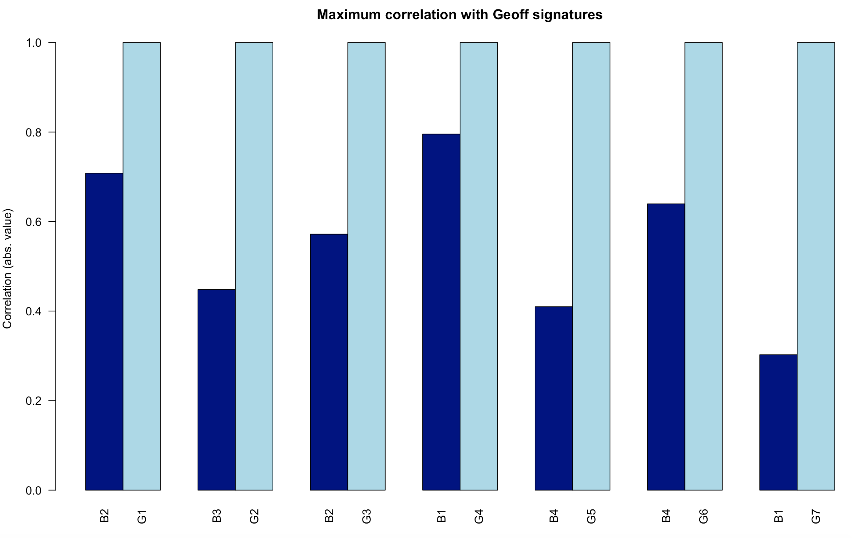
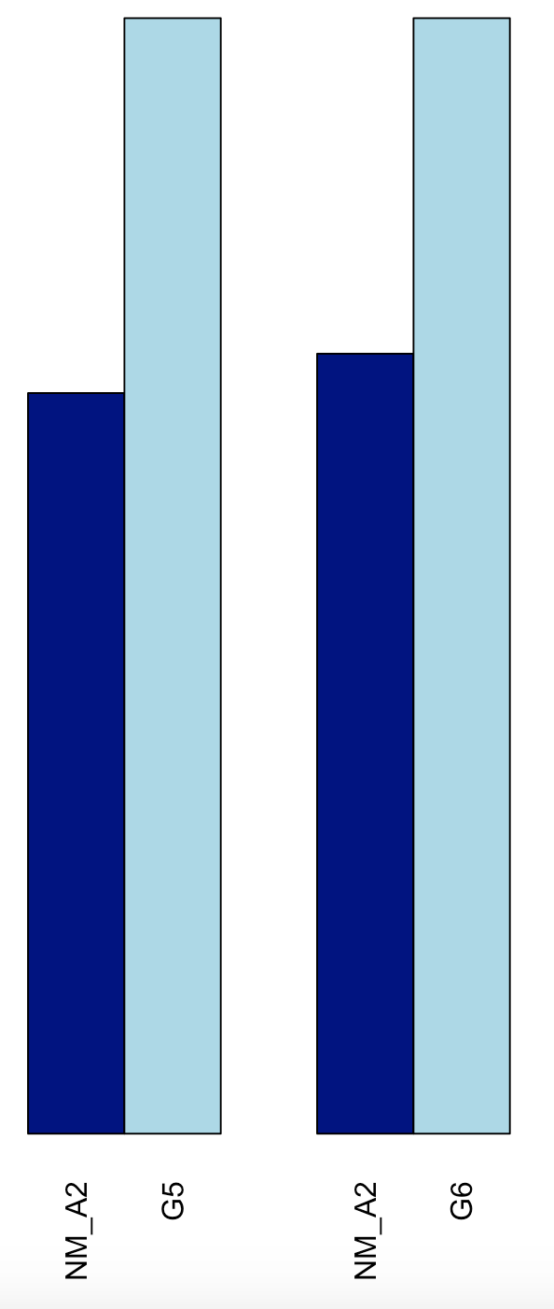
Comparison with Geoff’s signatures

Slide 48
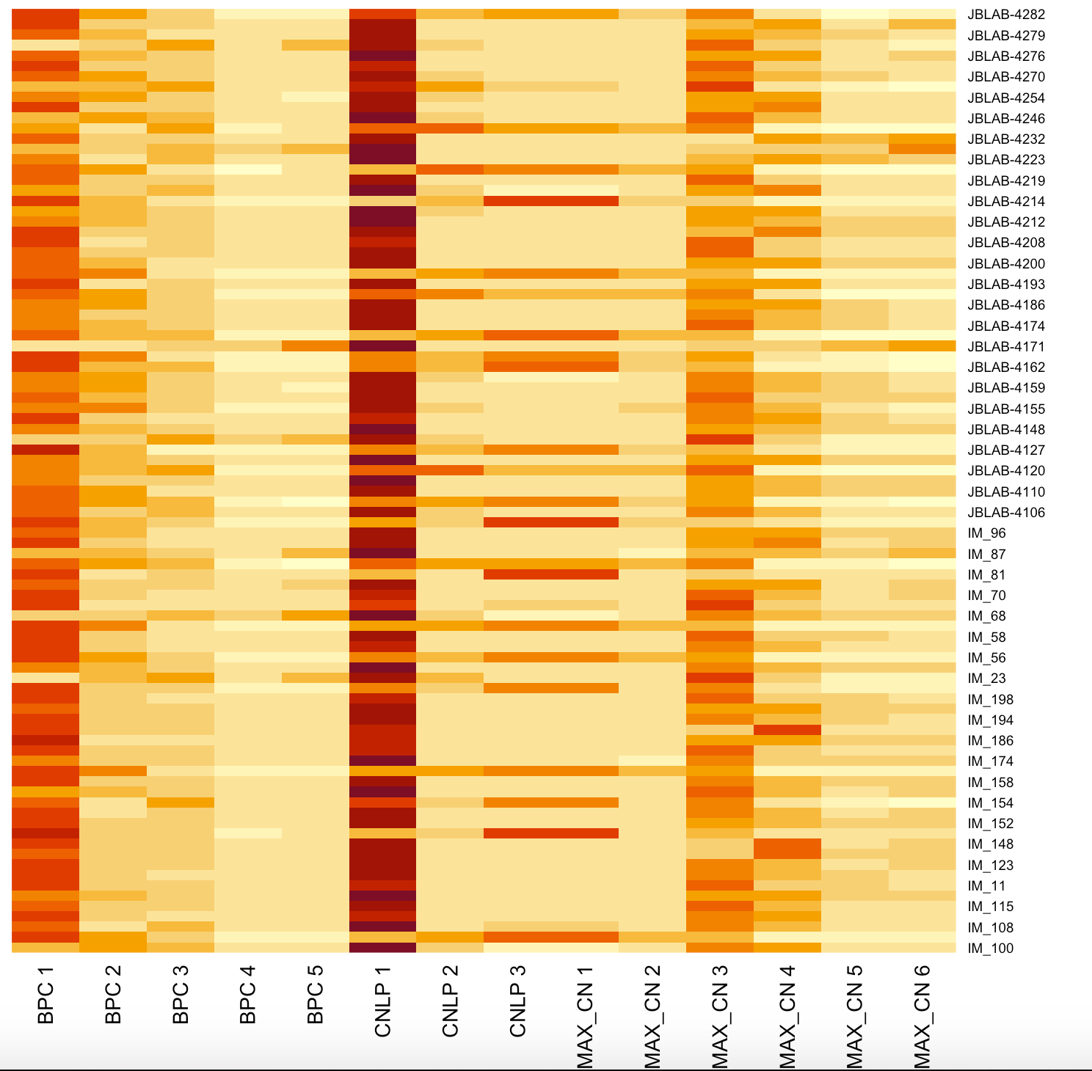
Sample by component matrix (Alternative 1)
Alternative 1:
- 3 features
- 14 Components
- 4 Signatures

Slide 49
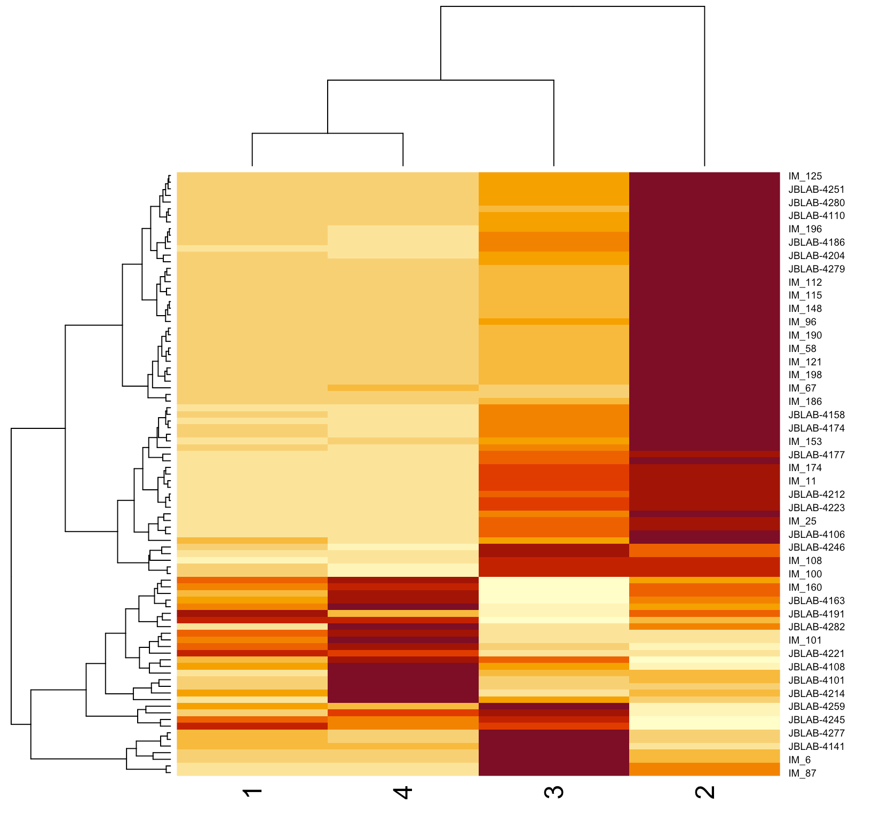
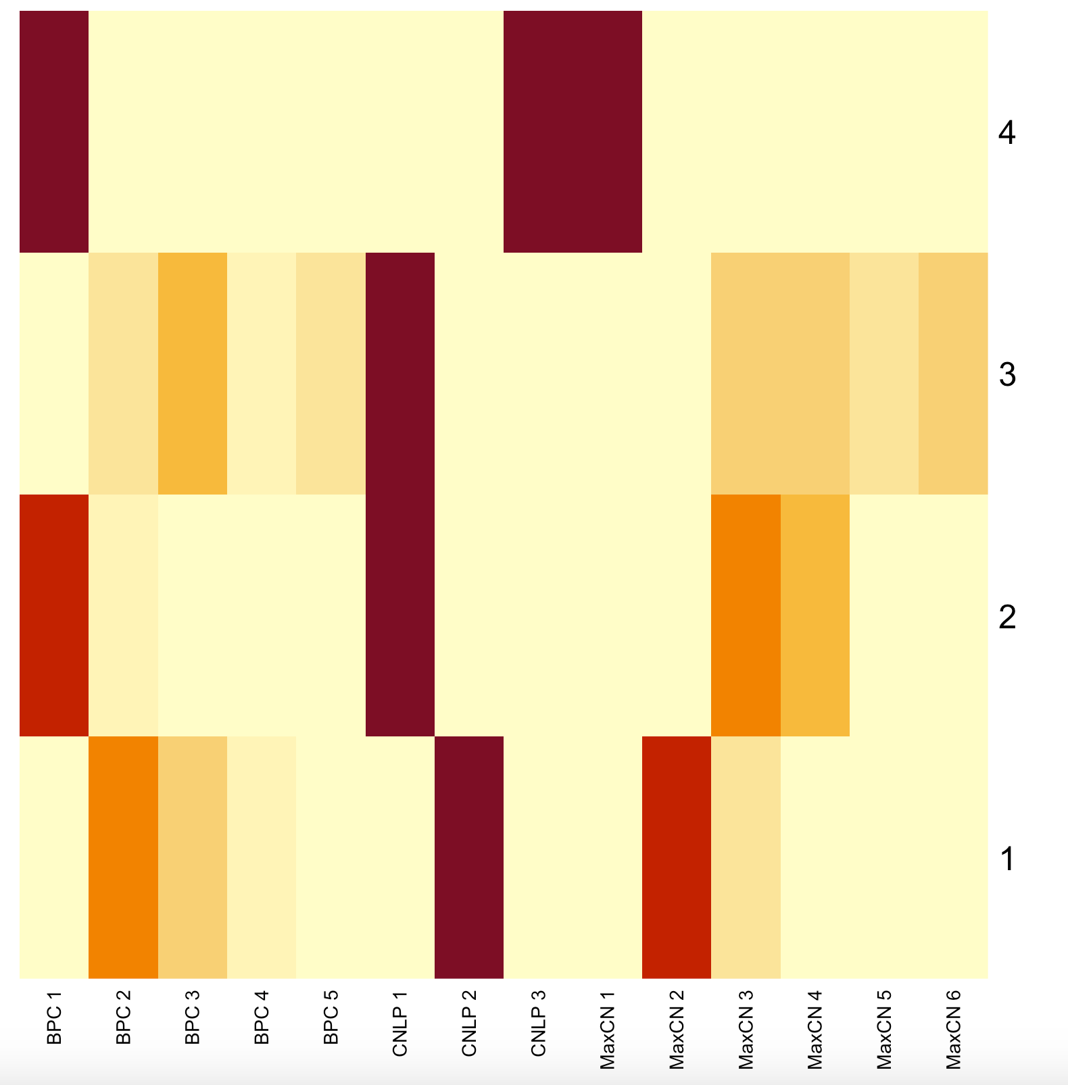
Main results for Alternative 1
Sample by Signature
Signature by Component

Slide 50
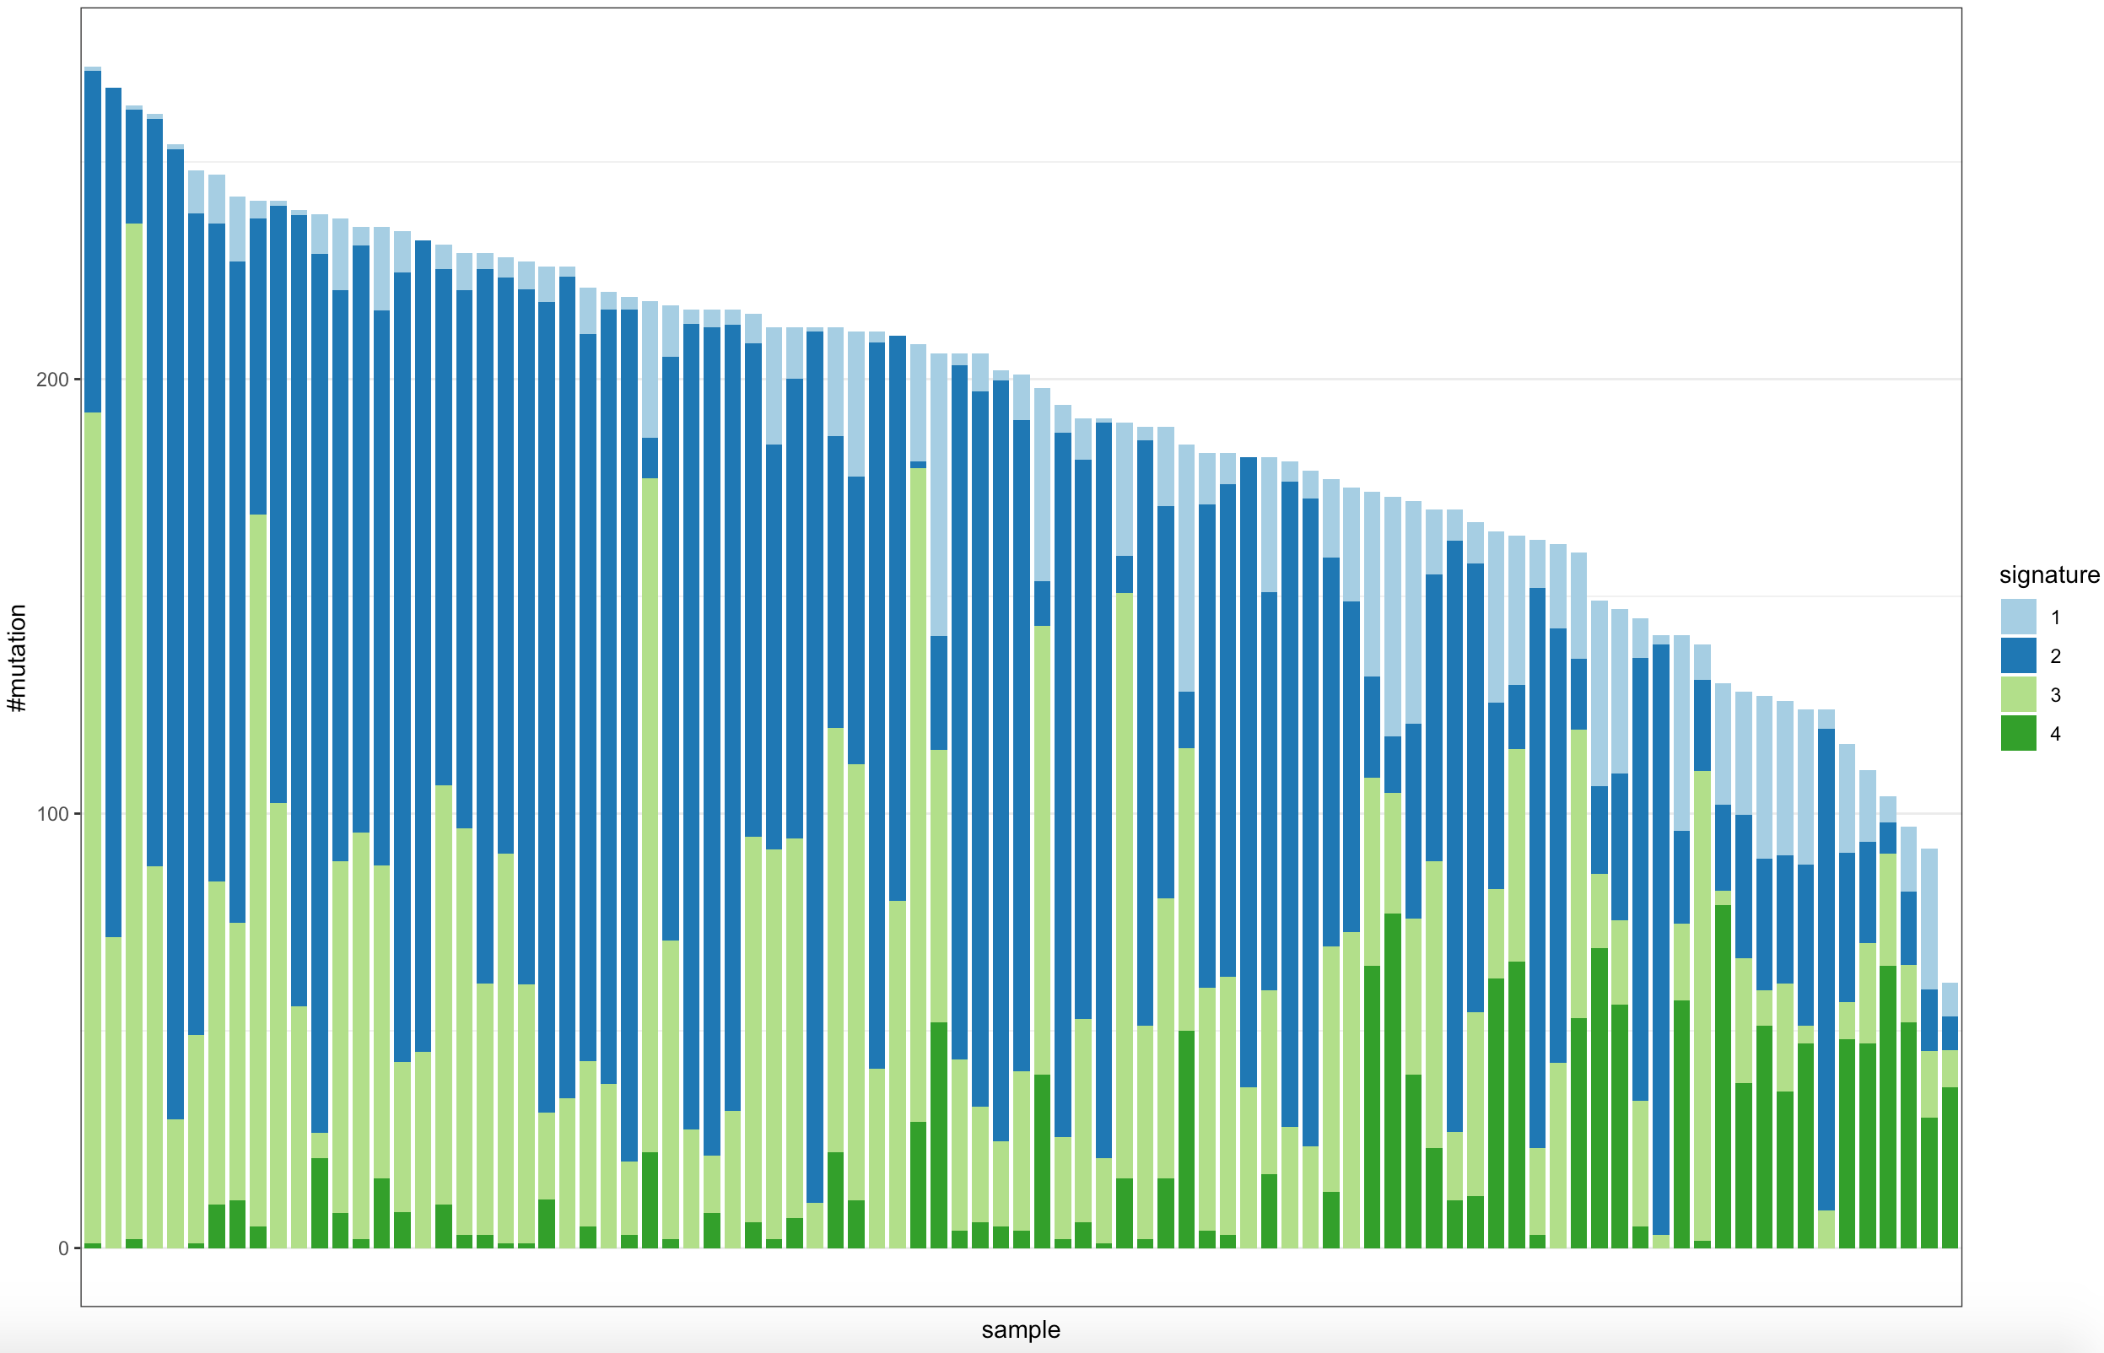
Signature exposures and number of mutated segments

Slide 51
Remaining
work

Slide 52
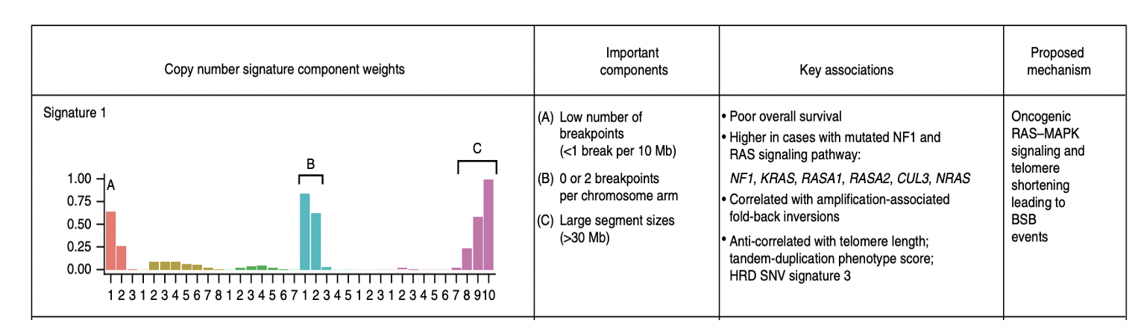
Things to include in the project / Future work
- Relate signatures to mutations of interest, e.g BRCA
- Study the presence of WGD in the samples
(Similar to Geoff’s paper)

Slide 53
Things to include in the project / Future work
- Use a larger dataset
- Combine the information from both alternatives
A1
Sample
A2

Slide 54
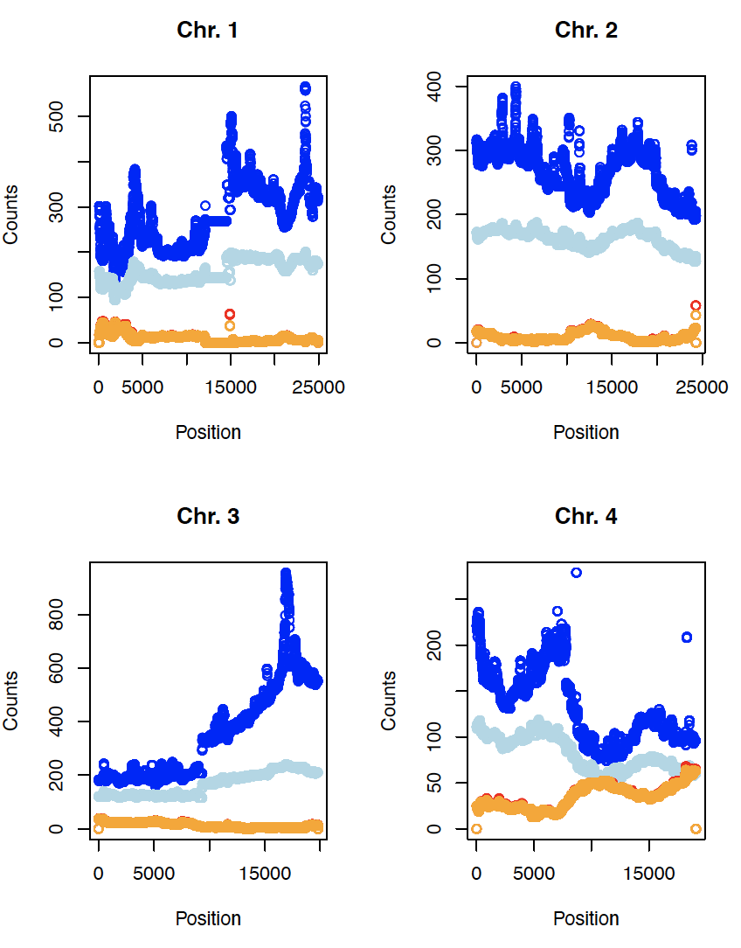
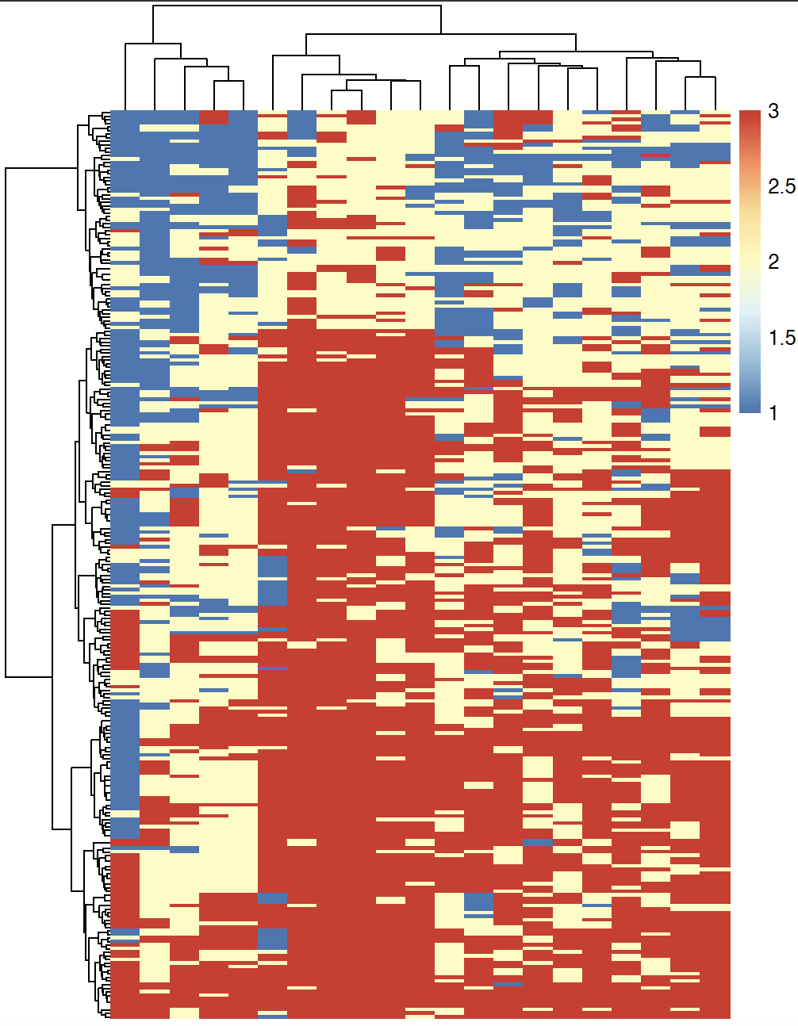
Things to include in the project / Future work
Relations with regions of interest in terms of CN

Slide 55
Special thanks to Lena, Florian
and everyone at the lab

